Slide 1
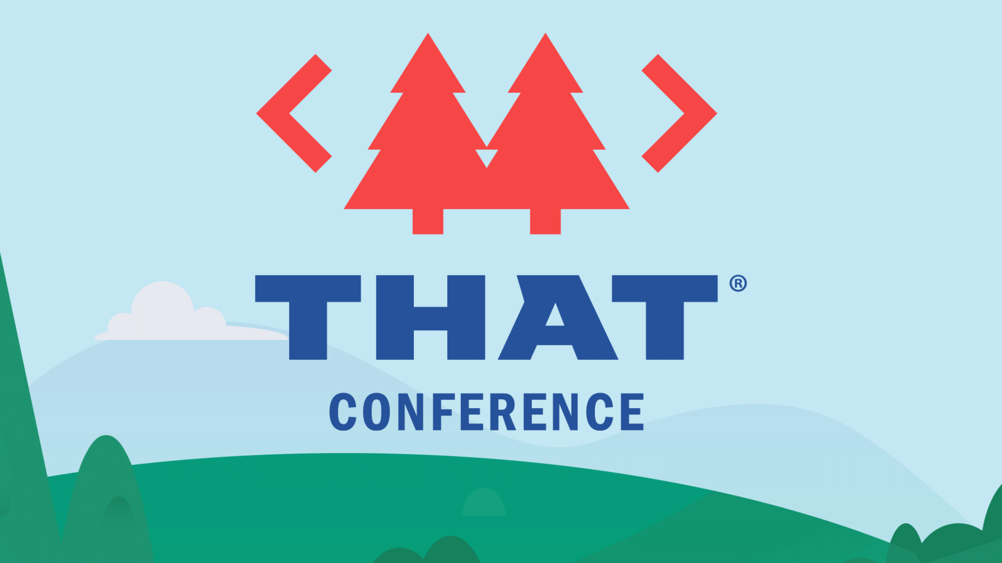

Slide 2
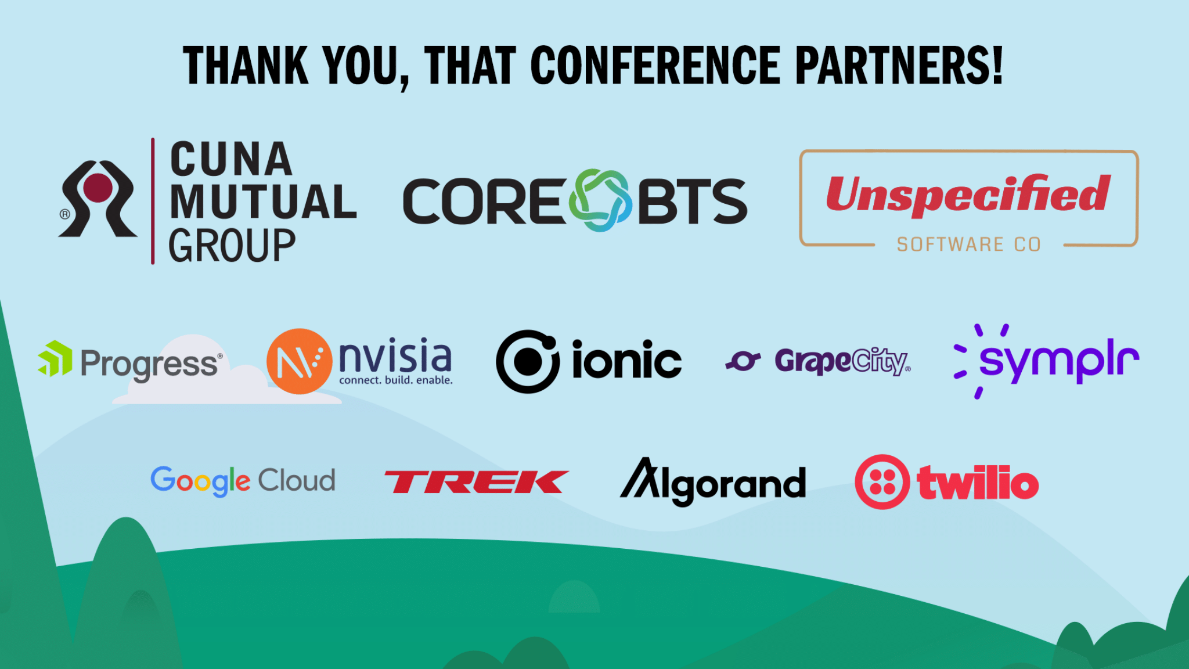

Slide 3


Flutter Away and
Never Look Back!

Slide 4
Who am I?
Graduated from UW-La Crosse in 2007
Husband and Father of 2 (15 & 12)
Started as software tester for a major medical provider in Southeast MN
Transitioned slowly to a full-time developer working in C#, Web, and Mobile
Certified Scrum Master

Slide 5
All presentation content available at
https://github.com/JoshRice1/flutterAwayAndNeverLookBack
Presentation will linked in the activity shortly after we are done

Slide 6


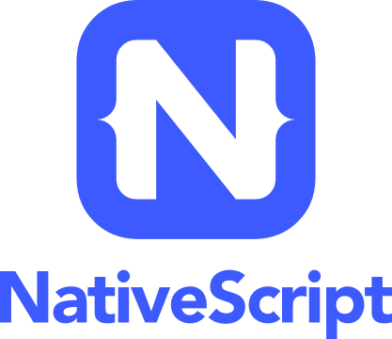

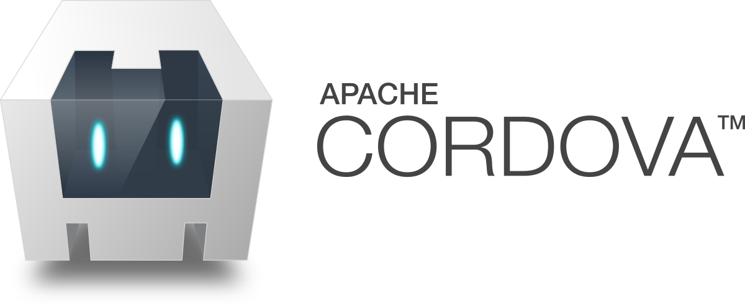
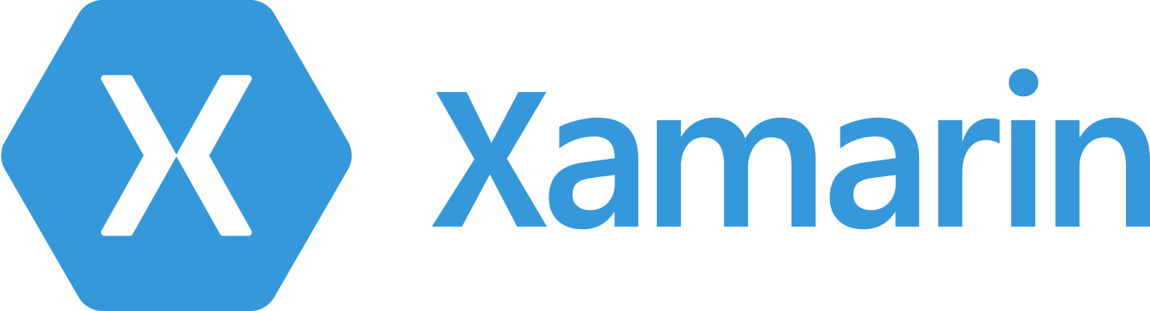
Cross-platform?
Definition: Cross-platform application development is about building a single application that can run on various operating systems, instead of developing different app versions for each platform (Native).

Slide 7
Why would anyone do native then?
Native |  |  | Cross Platform
Pros | Cons |  | Pros | Cons
Highest possible performance | Slower Dev* |  | Faster Dev* | Lower Performance
Immediate Access to new OS features | Higher Cost* |  | Lower Costs* | Slow adoption of new OS features
Native UI Look & Feel | Time Consuming |  | Consistency | UI/UX Issues
 |  |  | Wider Audience
* Indicates assumption of multi os support

Slide 8

So why would Google care?
Has a lot of apps itself and dev for each platform is really expensive
Fuchsia OS

Slide 9
So is Flutter Any Different?
“The goal is to enable developers to deliver high-performance apps that feel natural on different platforms, embracing differences where they exist while sharing as much code as possible.
During development, Flutter apps run in a VM that offers stateful hot reload of changes without needing a full recompile. For release, Flutter apps are compiled directly to machine code, whether Intel x64 or ARM instructions, or to JavaScript if targeting the web.”
https://flutter.dev/docs/resources/architectural-overview

Slide 10
Huh?
Soo...What does that mean?
Run at near native framerates
Supports (and even encourages) the differences in the platforms (ex: Cupertino Icons)
Faster development with hot reload (How did we live without this all these years)
Cross platform truly means cross platform from Android and iOS to Windows, MacOS, Linux and the web (Supported Platforms)

Slide 11
But why Dart?
Dart was chosen after ranking highest across a wide variety of criteria including:
Developer productivity
The majority of Flutter is built in the same language we give to our users, so we need to stay productive at 100k’s lines of code, without sacrificing approachability or readability of the framework and widgets for our developers.
Object-orientation
Wanted a language that’s suited to Flutter’s problem domain: creating visual user experiences and the vast majority of developers have experience with object-oriented development, making it easier to learn how to develop with Flutter
https://flutter.dev/docs/resources/faq

Slide 12
But why Dart? Cont.
Predictable, high performance
Empower developers to create fast, fluid user experiences, that means a language that both delivers high performance and predictable performance, without periodic pauses that would cause dropped frames was required
Fast allocation
The Flutter framework uses a functional-style flow that depends heavily on the underlying memory allocator efficiently handling small, short-lived allocations. This style was developed in languages with this property and doesn’t work efficiently in languages that lack this facility.
https://flutter.dev/docs/resources/faq

Slide 13
OK, OK, OK, But is it really easy to learn
Yes, why else would I be here?
Many great resources to get you up and running
Google Code Labs
Widget Catalog
Introductions to flutter for a variety of backgrounds
Android, iOS, React Native, Web, Xamarin.Forms
You Tube Series
Widget of the Week
Boring Flutter Show
Active community on many different forums
Open source (Can find examples of how to do thing in the library)
Lastly, Everything is a widget

Slide 14
Widget? The thing from Economics?
A widget is an immutable object that describes a specific part of a UI
Flutter widgets are composable, meaning that you can combine existing widgets to make more sophisticated widgets

Slide 15
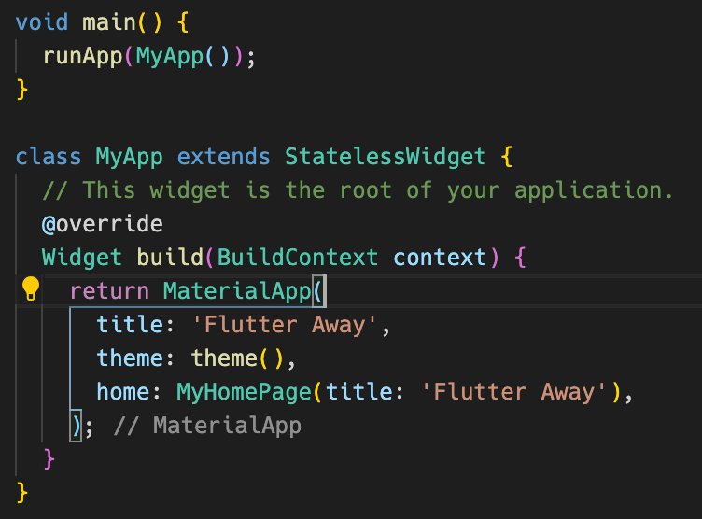
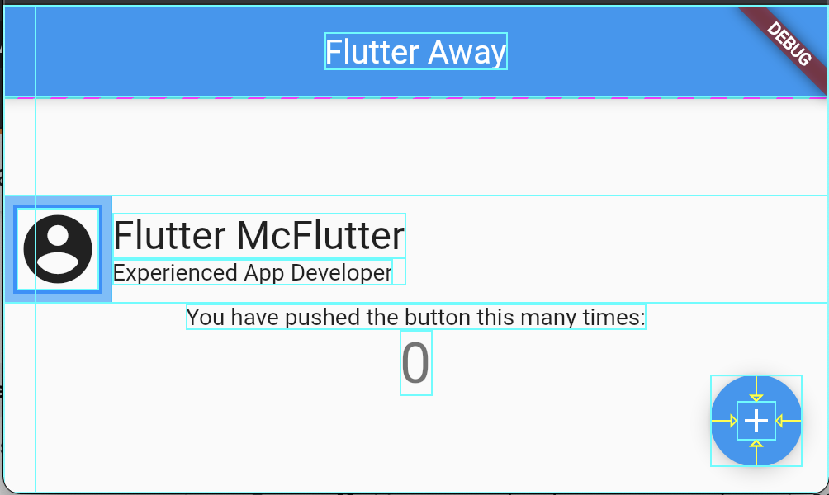
Lets Look at some Code

Slide 16
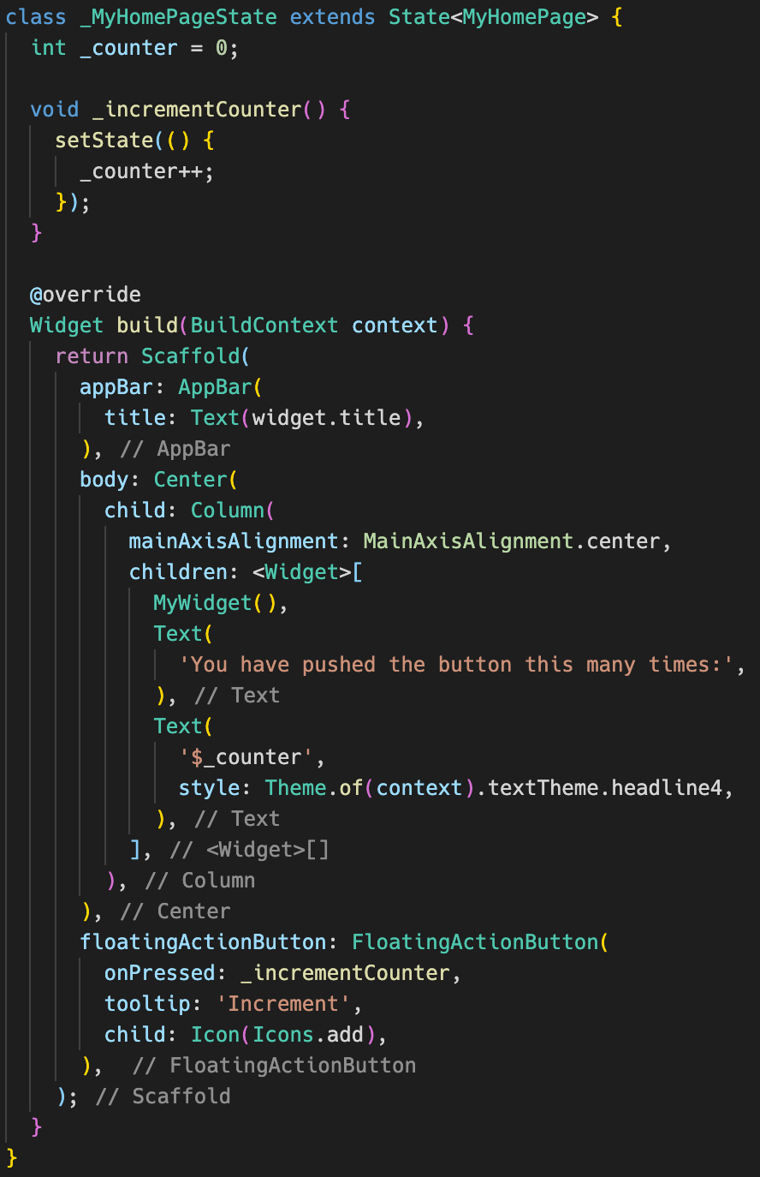
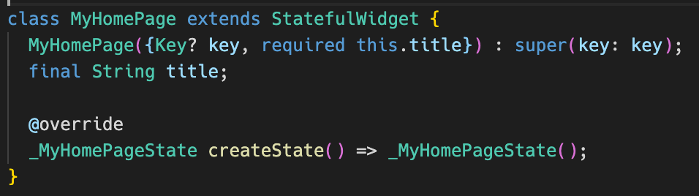
Home Page

Slide 17
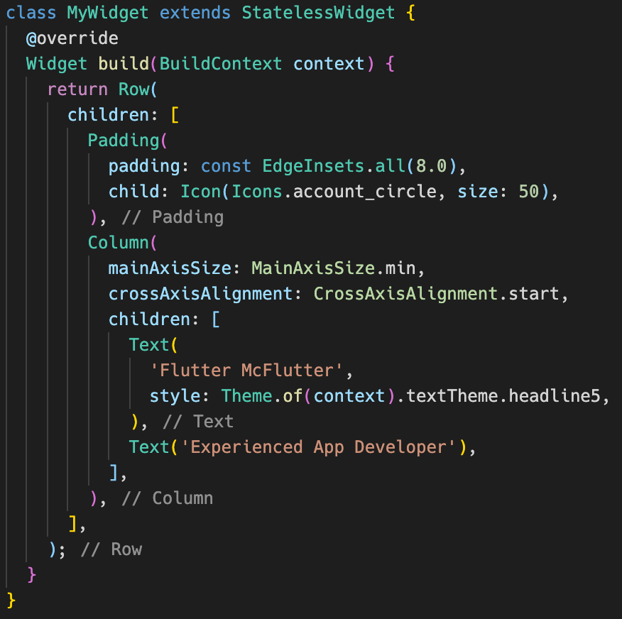
Composed Widget

Slide 18
It’s still new, any public assets?
Enter pub.dev
Over 25k packages (16K+ support null safety)
All packages are scored across 6 categories
Flutter Favorite program (Aims to promote the highest quality packages)

Slide 19
Other awesome tooling
Codemagic (CI/CD pipeline) https://codemagic.io/start/
Appainter (Theme Editor) https://appainter.dev/#/
Supernova (UI design to code {if you are fortunate enough to have a UX designer}) https://www.supernova.io/

Slide 20
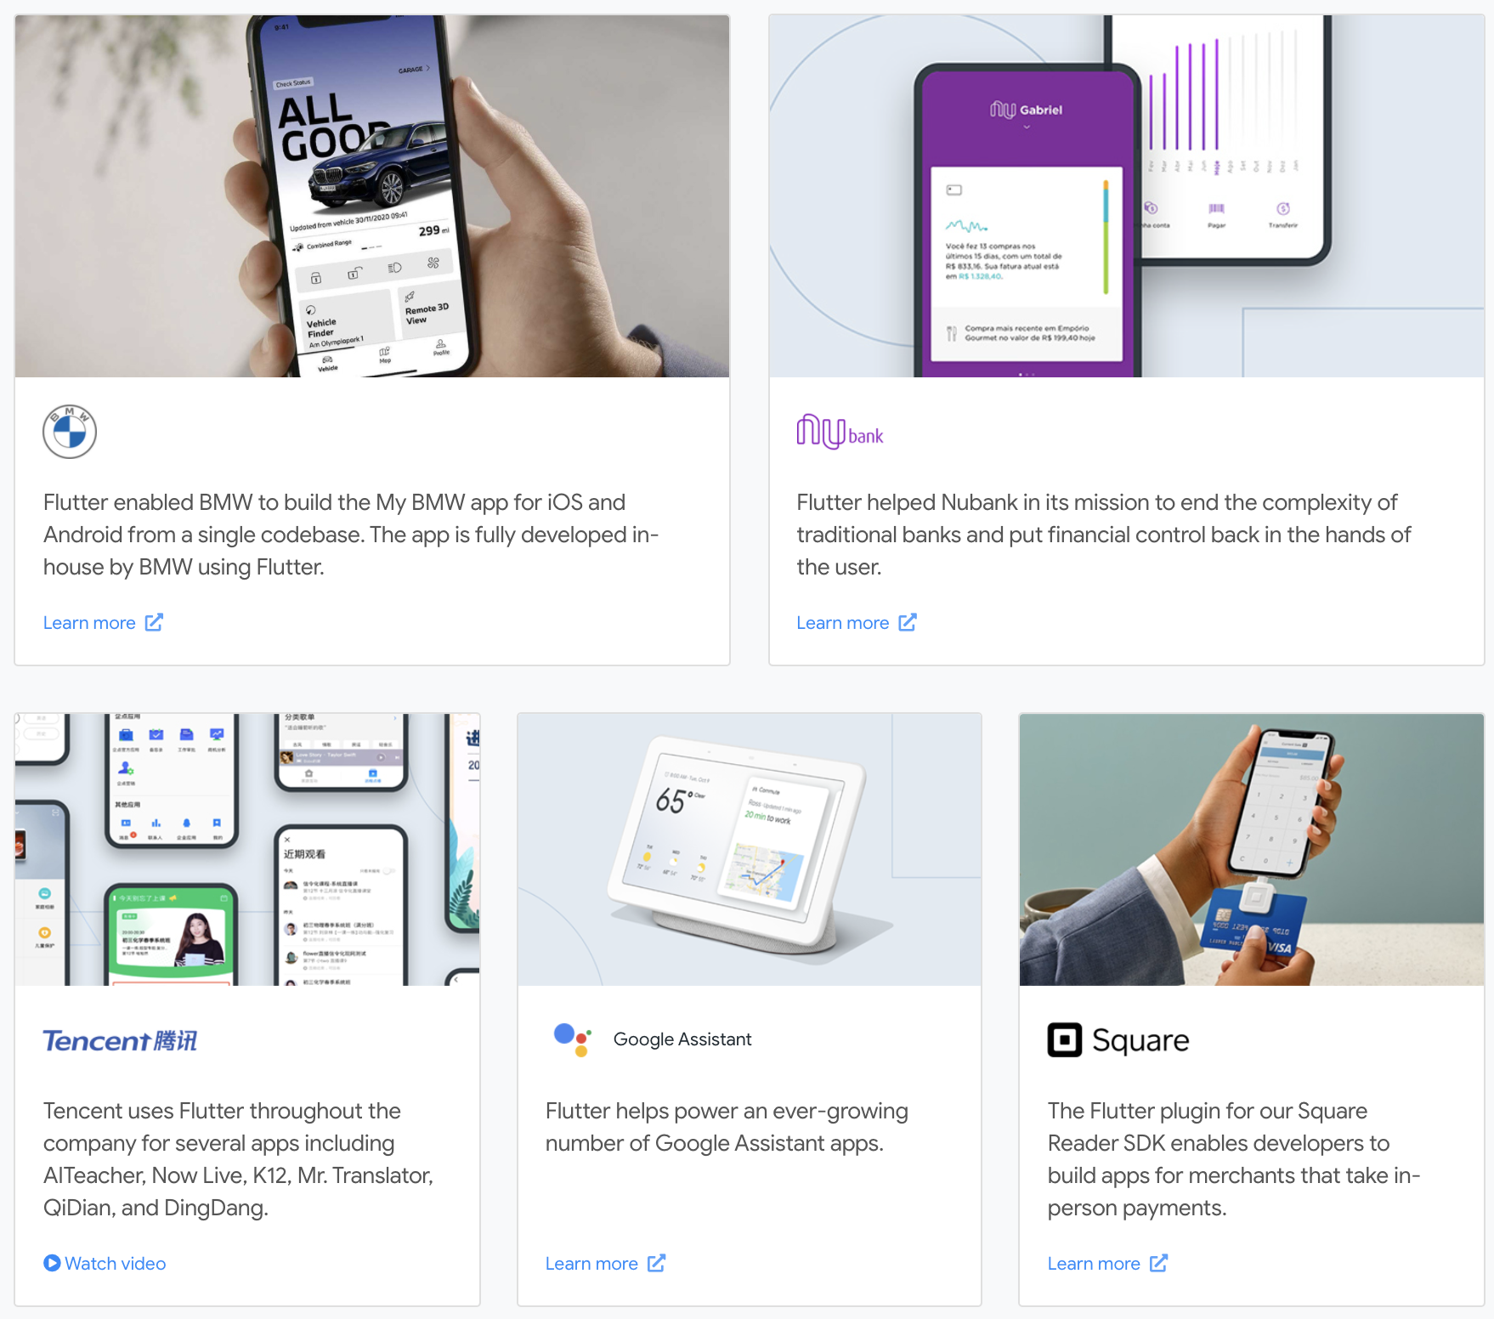
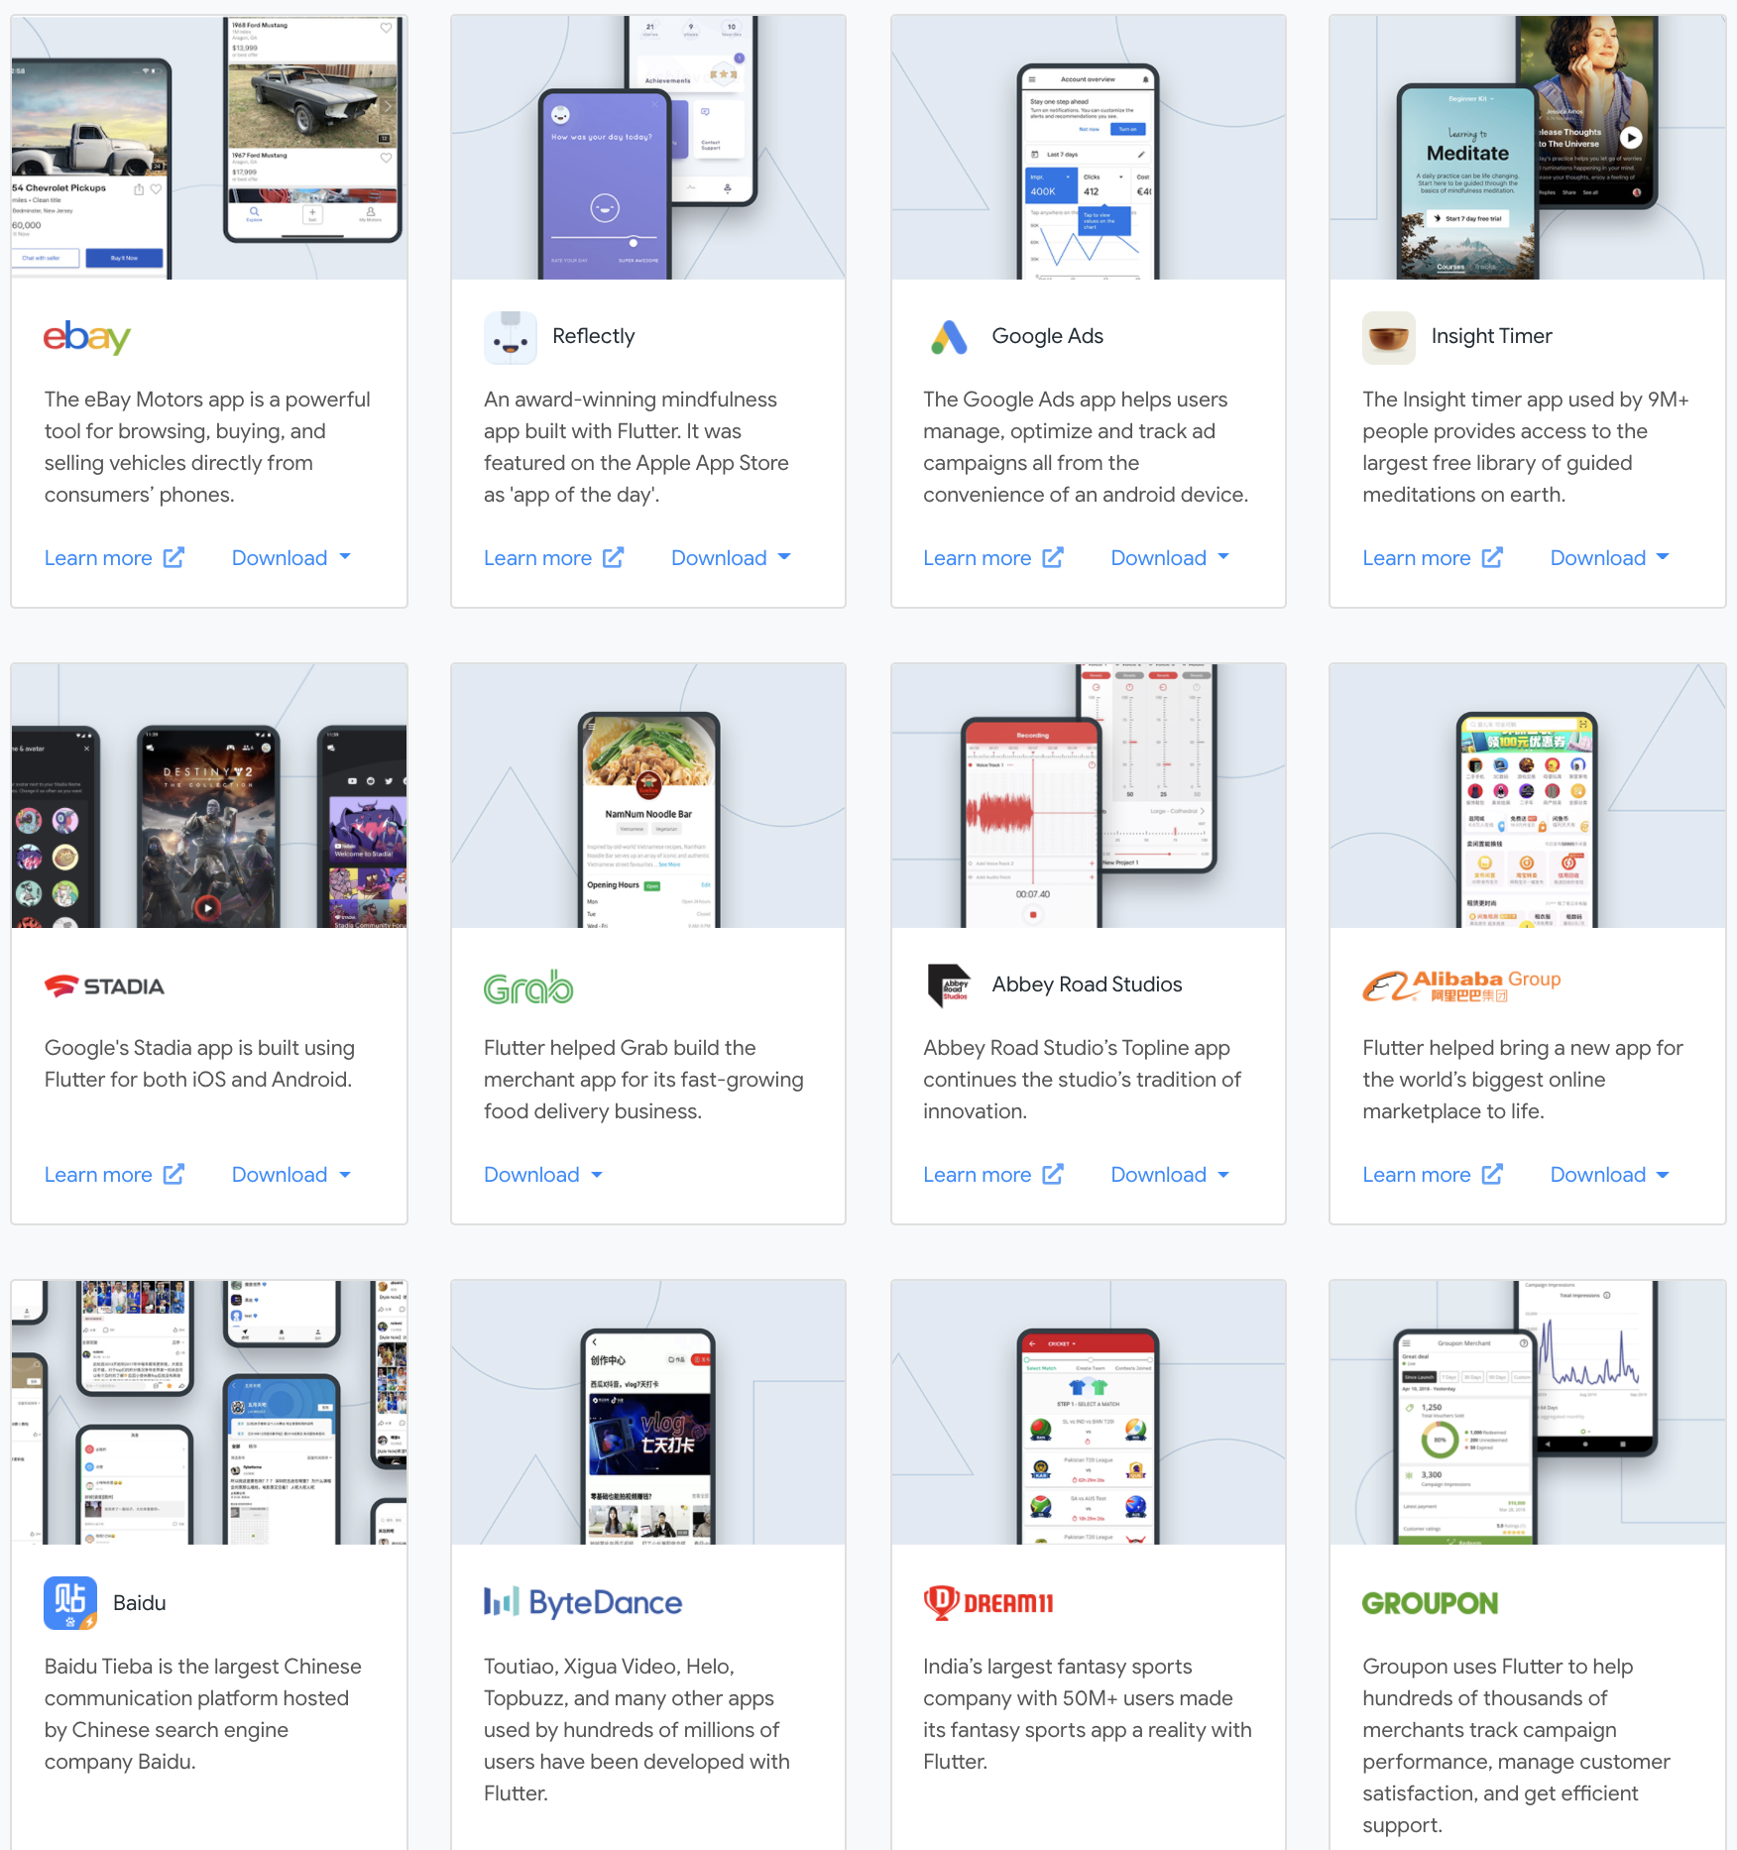
So besides you who is using it?
https://flutter.dev/showcase

Slide 21
Not ready to go whole hog?
Flutter can be added to your existing apps (iOS and Android) as a library or module
Can be used to render part of your UI in flutter
Or just to run shared Dart code (Business logic)
See https://flutter.dev/docs/development/add-to-app for more details

Slide 22
Things I wish I knew when starting
Get a good grasp of Provider and/or Bloc Patterns
Be selective when choosing packages
Be cautious of outdated information (Very active development)
Project Folder Structure (Updating refs can be a pain when moving files)

Slide 23


Slide 24
